Slide 1
Weekly report: Machine Bed & Yaw System
Week No - 11
Date: 09.12.2025
Supervisor: Prof. Peter Quell
Shoukat Abbas, Luksh Chawla, Sathishkumar Venkatachalam, Shrihari G Kadam
Presented by – Shrihari G Kadam

Slide 2
Contents
Calculation of Brake Caliper
Calculation of Braking Torque
No. of Brake calipers
Yaw Brake Disk Modification
Yaw System Finalization
Machine Bed Modification and Rear bed (welded part) concept design
References
Shrihari G Kadam

Slide 3
Calculation of Brake Calipers & Braking Torque
Clamping Force Determination
Clamping force taken from manufacturer’s performance graph (Svendborg BSAB-120).
Operating pressure: 16 MPa.
At 16 MPa and μ = 0.35, the graph gives a clamping force of:
FC ≈ 543 kN
Calculation of Braking Force (FB)
Formula (manufacturer catalogue):
FB = 2 × μ × FC
Where:
μ = coefficient of friction = 0.35
FC = Clamping force = 543 kN
FB = Braking force = 380.1 kN
[1]
Shrihari G Kadam

Slide 4
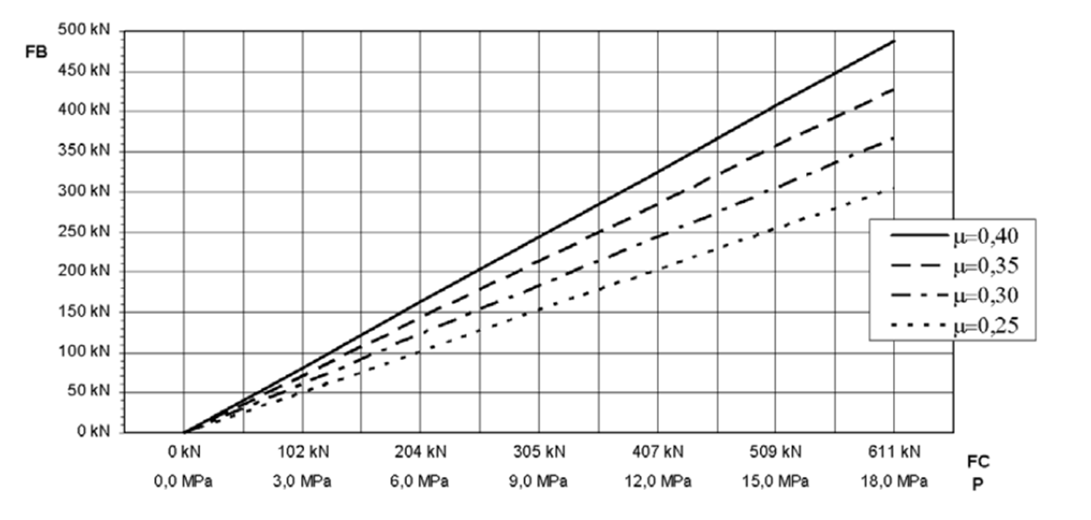
Calculation of Brake Calipers & Braking Torque
source : Svendborg Brakes [1]
Shrihari G Kadam

Slide 5
Calculation of Brake Calipers & Braking Torque
Calculation of Braking Torque (MB, caliper)
Manufacturer formula:
MB = FB × (Do − 0.136) / 2
Where:
FB = 380.1 kN
Do = brake disc outer diameter = 3.8 m
Substitution:
MB = 696.16 kNm per caliper
Summary
Clamping force: 543 kN
Braking force: 380.1 kN
Braking moment: 696.16 kNm
[1]
Shrihari G Kadam

Slide 6
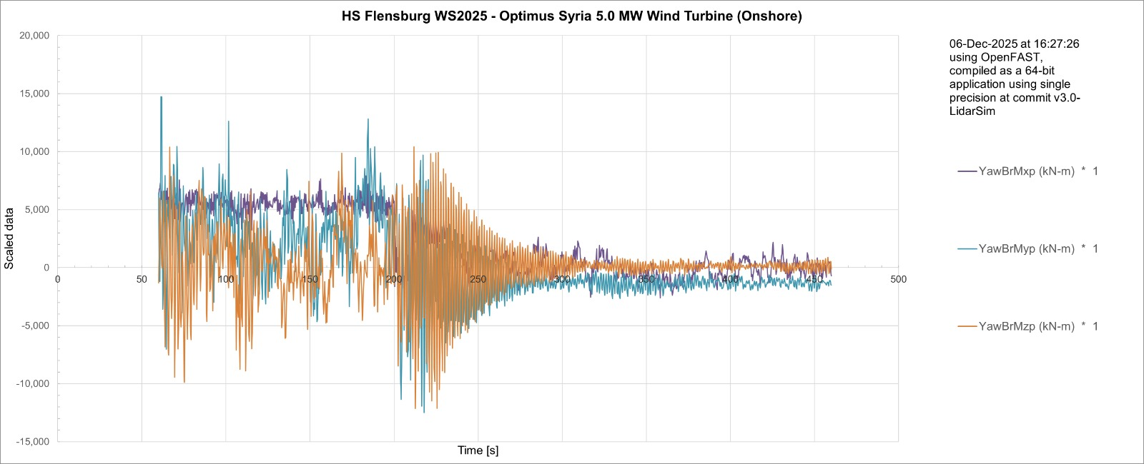
Calculation of Brake Calipers & Braking Torque
Calculation of no. of brake calipers
    DLC 5.1 Normal Turbulence mode @25 m/s (cut-out speed)
Source: Load and Dynamics team Optimus Syria
Shrihari G Kadam

Slide 7
Calculation of Brake Calipers & Braking Torque
Calculation of no. of brake calipers
  DLC 5.1 Normal Turbulence mode @25 m/s (cut-out speed)
    From the graph:
      Mz, yaw brake ≈ 10000 kNm
      a = no of brake calipers = Mz, yaw brake / MB
        = 1000 kNm / 696.16 kNm = 14.36
So, the number of brake calipers are 14 in Optimus Syria. Finalized numbers will be taken after confirmation from the Prof.
Source: Load and Dynamics team Optimus Syria
Shrihari G Kadam

Slide 8
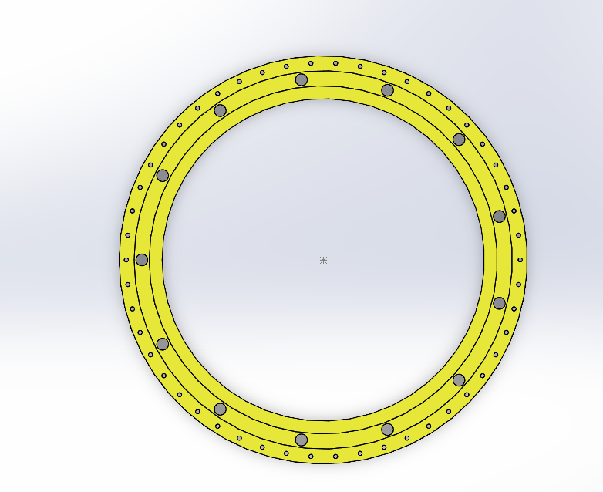
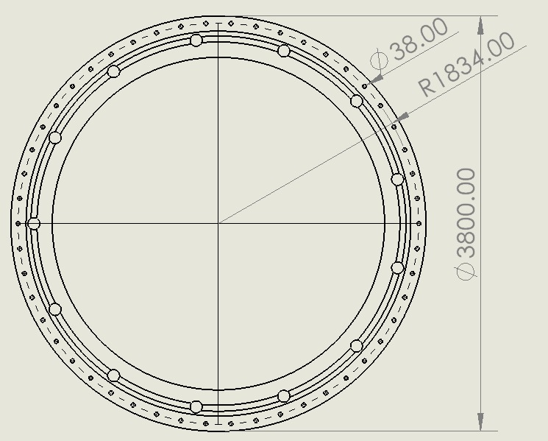
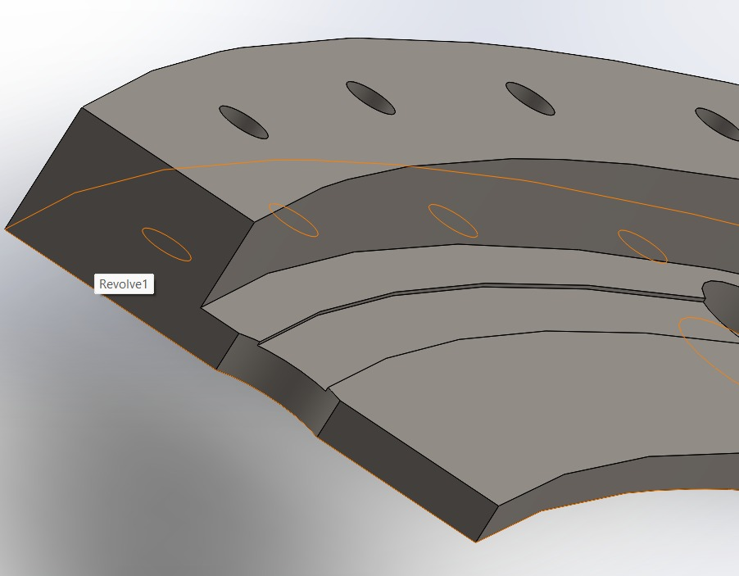
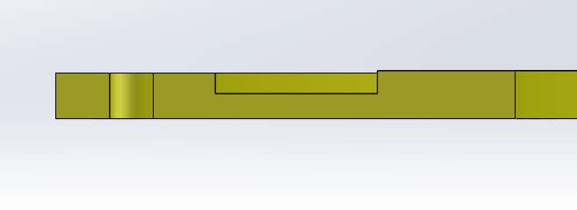
Yaw Brake – Modification Diff.
Yaw brake disk
Old Model – With Extra Boss
Modified New Brake
Shrihari G Kadam

Slide 9
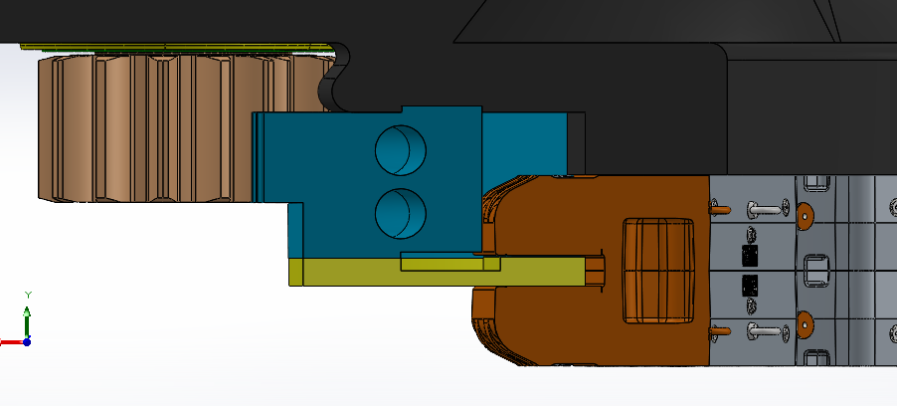
Yaw system Finalization
Yaw brake disk - 3D
Removed extra
Gears portions
Modified Design
Shrihari G Kadam

Slide 10
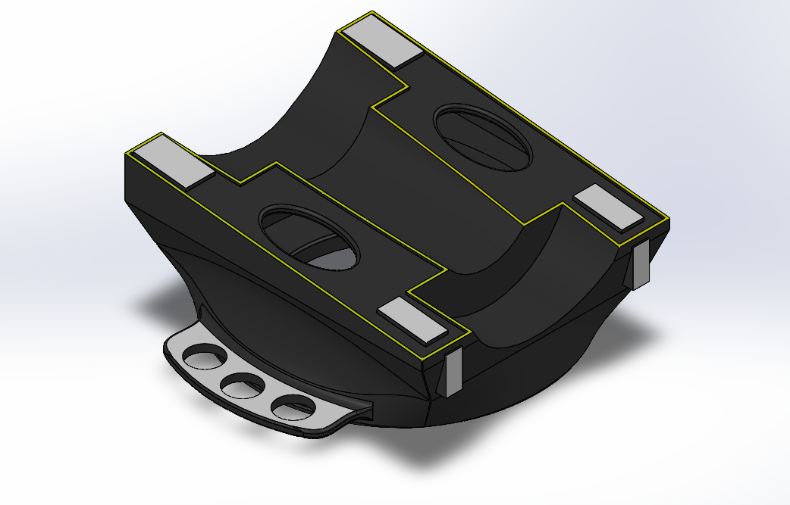
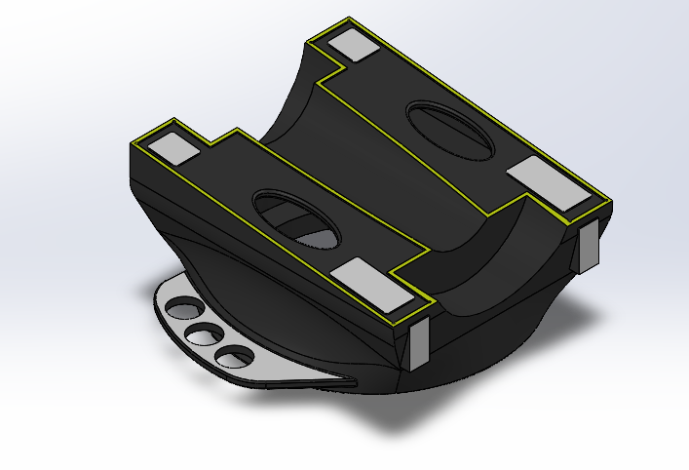
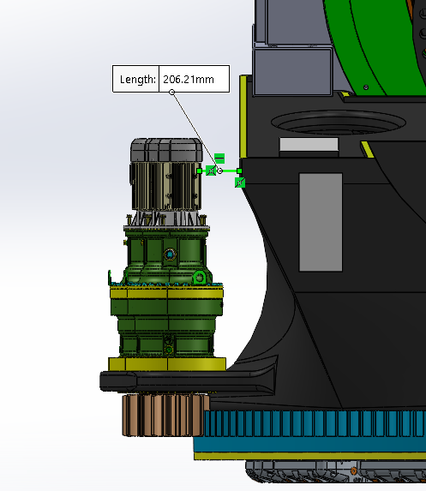
Machine Bed – Modification Diff.
Machine Bed - 3D
Modified Drive
flange
We have clear gap now!!
Shrihari G Kadam

Slide 11
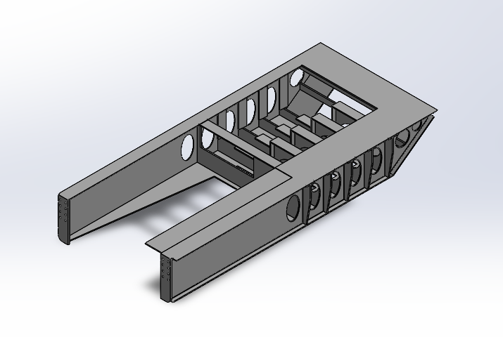
Rear Machine Bed – Concept
* Optimus model- Modified dimension according to our casted bed - Concept Design
Shrihari G Kadam

Slide 12
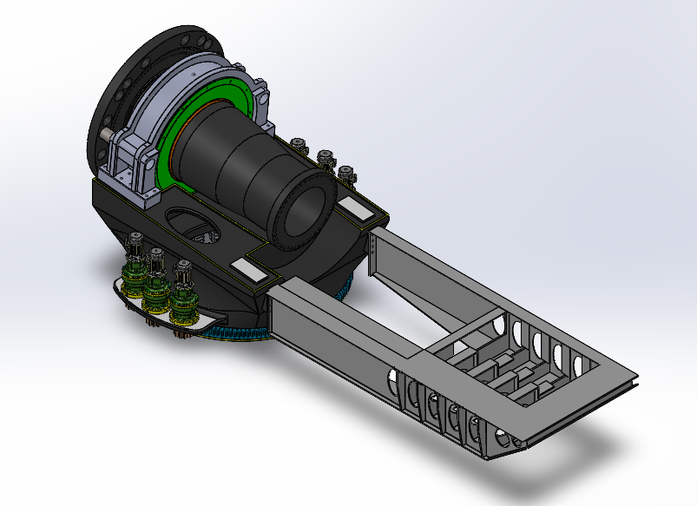
Updated Machine Bed & Yaw System Ass.
Shrihari G Kadam

Slide 13
References
    [1]. Hydraulic brakes Svensborg brakes, https://www.svendborg-brakes.com/products/hydraulic-brakes/active-brakes/bsab-120/ (accessed: 13.11.2025)
Shrihari G Kadam

